Slide 1
CMPE 220
Class 16 – Developing System Software Software Engineering Considerations
Notes:
Let’s talk about history.
California State Railroad Museum – 1976 - docents worked on original steam engines.

Slide 2
Types of Software
Applications (specializations)
Financial
Scientific / Medical
Data Science / Big Data / Statistics / Modeling
Educational
Games
Web Applications
Software Development Tools
Servers (Web, Database, Email, FTP, etc)
Operating System Software
Embedded Systems (applications and systems)

Slide 3
Which is Hardest?
Each has its own challenges – but the skills are different
Some people find multi-threaded, asynchronous coding to be particularly difficult
System software engineers are paid slightly more
Median Salaries (US Department of Labor, 2019)
Application software developer: $103,620
System software developer: $110,000

Slide 4
Types of Software Development
 | Applications | Web Applications | Software Development Tools | Servers (FTP, Web, Database, Email) | Operating Systems | Embedded Systems
Knowledge of application | YES | YES |  |  |  | YES
Knowledge of hardware |  |  | YES |  | YES | YES
Knowledge of standards |  | MAYBE | YES | YES | MAYBE
Performance Sensitive |  | YES |  | YES | YES | YES
Memory Sensitive |  |  |  |  | YES | YES
Process Management |  | MAYBE |  | YES | YES

Slide 5
Software Development Processes
 | Applications | Web Applications | Software Development Tools | Servers (FTP, Web, DB, Email) | Operating Systems | Embedded Systems
Formal Specifications | VARIES | VARIES | YES | YES | YES | VARIES
Languages | ANY | PHP, JavaScript, Ruby, Python | ANY | C, C++, JAVA | C, C++, JAVA, Assembly | Assembly, C, C++, Python, Ada, Rust, Go
Release cycles | RAPID | VERY RAPID | SLOW | MODERATE | SLOW | SLOW
Testing (Risk) | VARIES | VARIES | EXTENSIVE | EXTENSIVE | EXTENSIVE | VARIES

Slide 6
Software Development Life Cycle (SDLC)
A software development life cycle (SDLC) model is a conceptual framework describing all activities in a software development project from planning to maintenance.
Major Models
None
Waterfall (traditional)
Spiral
Agile / Scrum
DevOps

Slide 7
SDLC: None
1940s to mid-1950s
Programs were small
Features were limited
Few programmers per project
The entire project could be planned and tracked on a notepad

Slide 8
SDLC: Waterfall (traditional)
First formal description of an SDLC - 1956
First use of the term Waterfall -1976
US Department of Defense standardizes Waterfall model – 1985
Phases are linear:
Gather Requirements
Write Functional Specification
Write Internal Design
Develop Code
Test
Release
Maintain

Slide 9
Waterfall Documentation
Market Requirements
Functional Specification
System Architecture (Software Design)
Test Plan
2.1.9.4 …
2.1.9.4 …
2.1.9.4 …
2.1.9.4 …

Slide 10
Waterfall Pros and Cons
Pros
Easy to understand
Encourages large up-front investment in requirements analysis and planning
Allows separation of teams
Lends itself to tracking
Each requirement -> feature -> implementation -> test
Well suited for delivery contracts
Well suited for legal compliance

Slide 11
Waterfall Pros and Cons
Cons
Requirements may be wrong
Functional Specifications may dictate poor design
Little communication between teams
Changes are difficult
Testing is late in the cycle
Tracking can be slow and expensive
Release cycles are typically long
Overly restrictive – and may be ignored

Slide 12
SDLC: Spiral
First described by Barry Boehm - 1986
A series of short waterfalls
Overall project is loosely defined
Project plan calls for a series of phases; each phase presents an opportunity to refine and correct the previous phase

Slide 13
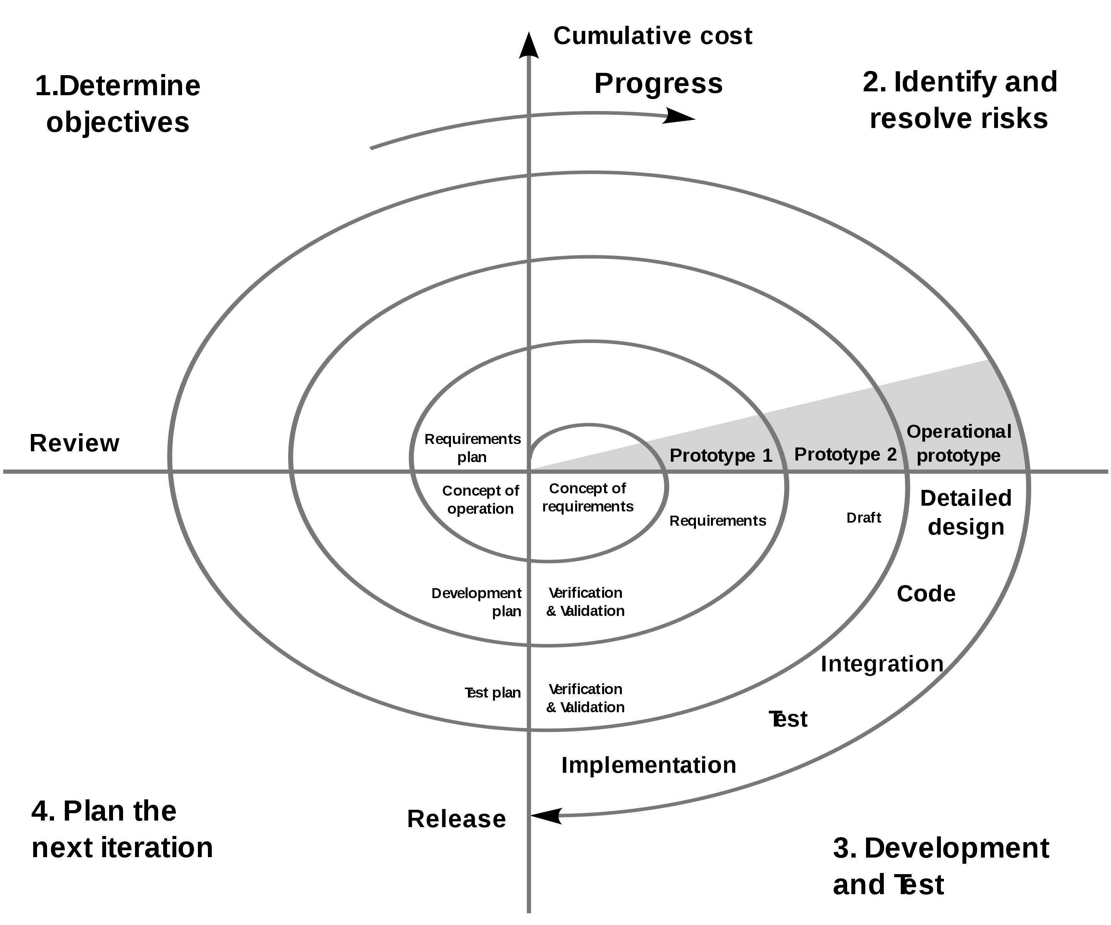
SDLC: Spiral

Slide 14
Spiral Pros and Cons
Pros
All of the Pros of the traditional Waterfall model
Catches incorrect requirements earlier
Changes are easier
Testing is earlier in the cycle
Well suited to longer projects

Slide 15
Spiral Pros and Cons
Cons
Slower and more expensive than traditional waterfall
More difficult to track
Harder to tie to delivery contracts

Slide 16
SDLC: Rapid Application Development (RAD)
Use existing components and tools to develop and release a “prototype” very quickly
May fill competitive gaps
May be used to get user feedback
May be a throw-away effort

Slide 17
RAD Pros and Cons
Pros
Fast!
Takes advantage of existing tools and components
Mitigates risk

Slide 18
RAD Pros and Cons
Cons
Requires experienced, skilled developers
Expensive (throw-away)
May commit organization to support of throw-away code

Slide 19
SDLC: Agile
Steps to Agile Development
Mostly streamlining the process
Rapid Application Development (RAD) – 1991
Dynamic Systems Development Methodology (DSDM) – 1994
Scrum – 1995
Extreme Programming (XP) – 1996
The “Agile Manifesto” – 2001
Written by 17 software developers at a resort in Snowbird, Utah

Slide 20
SDLC: Agile
Continuous stakeholder involvement
Short, overlapping define -> implement -> test cycles (sprints)
Team approach: stakeholders, designers, developers, testers work together throughout the project
Continuous communication
Frameworks
Scrum – an organizational framework for managing agile development
Kanban – a visual workflow management system allows all team members to visualize project status

Slide 21
Agile Pros and Cons
Pros
High degree of stakeholder satisfaction
Easy to make changes
Bugs are found early
Allows frequent releases to roll out new features and bug fixes

Slide 22
Agile Pros and Cons
Cons
Difficult to manage
Difficult to scale
Encourages feature creep…. Projects can easily “go off the rails”
May be expensive (ties up teams, frequent meetings)
Poorly suited for delivery contracts
“Continuous change” is hard on:
People who write documentation & training materials
Support staff
Users!

Slide 23
SDLC: DevOps
DevOps coined by Belgian developer Patrick Debois – 2009
A methodology that integrates development, deployment, and ongoing operations (IT) – continuous deployment
The development cycle doesn’t end when the product is released
Emphasis on automated delivery tools

Slide 24
DevOps Pros and Cons
Pros
All advantages of Agile:
High degree of stakeholder satisfaction
Easy to make changes
Bugs are found early
Allows frequent releases to roll out new features and bug fixes
Significant improvements in operations

Slide 25
DevOps Pros and Cons
Cons
All Cons of Agile:
Difficult to manage
Encourages feature creep…. Projects can easily “go off the rails”
May be expensive (ties up teams, frequent meetings)
Poorly suited for delivery contracts
“Continuous change” is hard
Requires automated testing and deployment tools

Slide 26
DevOps: A Partial Solution
Unserved Communities
Technical support
Tech Writers
Marketing
Customers

Slide 27
Additional Wrinkles

Slide 28
Lean Software Development (LSD)
An Agile variant designed to reduce wasted effort
Also called MVP, or Minimum Viable Product strategy
Release a bare-minimum version of the product (or feature). Learn what users like and don’t like, or want to see added, then iterate based on feedback.
Anything that does not contribute to the MVP is eliminated.

Slide 29
Lean History
Based on techniques developed at Japanese auto-maker Toyota in the 1960s
Developed by Taiichi Ohno, the Toyota Production System (TPS) was aimed at minimizing waste
Popularized as a development methodology in the book Lean Thinking: Banish Waste and Create Wealth in Your Corporation, by James Womack and Danial Jones (2003)

Slide 30
Developer Testing
Traditional model
Developers write code, quality assurance (QA) tests the code
Developers typically perform basic unit/functional testing
QA is responsible for overall system testing

Slide 31
Traditional Testing Model: Problems
Little incentive for developers to create high-quality code
Duplication of effort (developer tests and QA tests)
Bugs are found late in the release cycle
Multiple fix & test cycles required
Potential for disastrous schedule slips!

Slide 32
Developer Testing
Developers and development team is responsible for:
Creating and submitting unit/functional tests
Automation frameworks allow easy “regression tests”
Commercial / proprietary tools
Make!
Static Code Analysis
“Lint”
Coding standards
Specific security or performance issues
Source Code Control: Check-in “gates”
Development team is responsible for:
Integration testing and submitting tests

Slide 33
Risks / Cons of Developer Testing
Expensive and time time-consuming
Developers are not expert testers
Morale issues

Slide 34
Software Development Processes: Fit
The best “fit” for developing a particular type of software is a matter of opinion, and based on specific circumstances. The table below is intended as a basis for discussion.
 | Applications | Web Applications | Software Development Tools | Servers (FTP, Web, DB, Email) | Operating Systems | Embedded Systems
Waterfall | VARIES | NO | YES | YES | YES | YES
Spiral | VARIES | NO | YES | YES | YES | YES
Agile | VARIES | YES | NO | YES | NO | NO
DevOps | VARIES | YES | NO | YES | YES | NO

